Slide 1
Progress and Performance Measurement and Evaluation
Chapter 13

Slide 2
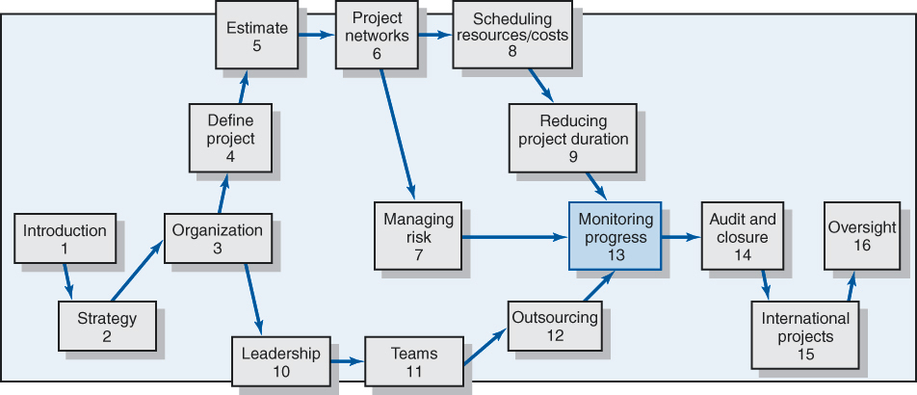

Slide 3
Project Monitoring System for Control
Information System Structure
  What data are collected?
    Current status of project (schedule and cost)
    Remaining cost to compete project
    Date that project will be complete
    Potential problems to be addressed now
    Out-of-control activities requiring intervention
    Cost and/or schedule overruns and the reasons for them
    Forecast of overruns at time of project completion

Slide 4
Project Monitoring System… (cont’d)
Information System Structure (cont’d)
  Collecting data and analysis
    Who will collect project data?
    How will data be collected?
    When will the data be collected?
    Who will compile and analyze the data?
  Reports and reporting
    Who will receive the reports?
    How will the reports be transmitted?
    When will the reports be distributed?

Slide 5
Project Progress Report Format
Progress Since Last Report
Current Status of Project
  Schedule
  Cost
  Scope
Cumulative Trends
Problems and Issues Since Last Report
  Actions and resolution of earlier problems
  New variances and problems identified
Corrective Action Planned

Slide 6
The Project Control Process
Control
  The process of comparing actual performance against plan to identify deviations, evaluate courses of action, and take appropriate corrective action
Project Control Steps
  Setting a baseline plan
  Measuring progress and performance
  Comparing plan against actual
  Taking actions

Slide 7
Monitoring Time Performance
Tools Used to Catch Negative Variances from Plan and Communicate Project Schedule Status:
  Tracking and baseline Gantt charts
    Show expected, actual, and trend data for event duration performance
  Control charts
    Plot the difference in scheduled time on the critical path with the actual point on the critical path

Slide 8
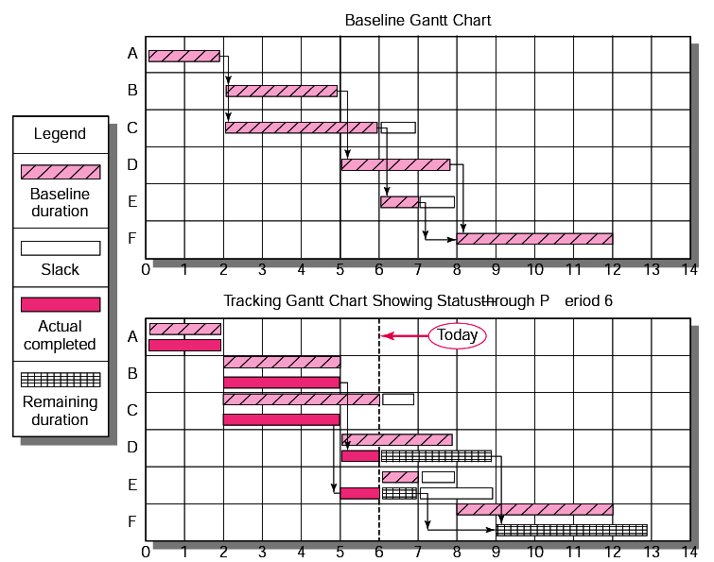
Baseline and Tracking Gantt Charts

Slide 9
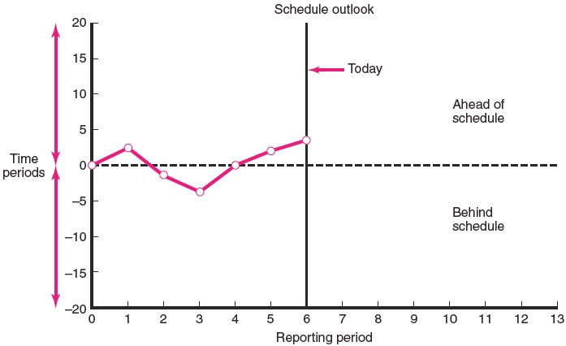
Project Schedule Control Chart

Slide 10
Disparity Among Monitoring Systems
Time-Phase Baseline Plan
  Corrects the failure of most monitoring systems to connect a project’s actual performance to its schedule and forecast budget
    Systems that measure only cost variances do not identify resource and project cost problems associated with falling behind or progressing ahead of schedule.
Earned Value Cost/Schedule System
  An integrated project management system based on the earned value concept that uses a time-phased budget baseline to compare actual and planned schedule and costs

Slide 11
Glossary of Terms
EV
  The percent complete times its original budget. The percent of the original budget that has been earned by actual work completed. The older acronym for this value was BCWP—budgeted cost of the work performed.
PV (Planned Value)
  The time-phased baseline of the value of the work scheduled. An approved cost estimate of the resources scheduled in a time-phased cumulative baseline (BCWS—budgeted cost of the work scheduled).
AC
  The actual cost of the work completed. The sum of the costs incurred in accomplishing work. (ACWP—actual cost of the work performed).

Slide 12
Glossary of Terms
CV
  Cost variance is the difference between the earned value and the actual costs for the work completed to date where CV=EV-AC.
SV
  Schedule variance (SV) is the difference between the earned value and the baseline line to date where SV=EV-PV.
BAC
  Budgeted cost at completion. The total budgeted cost of the baseline or project cost accounts.
EAC_{re}
  Estimated costs at completion. Includes costs to-date plus revised estimated costs for the work remaining.

Slide 13
Glossary of Terms
ETC
  Estimate to complete.
VAC
  Cost variance at completion (BAC-EAC_{re}), where EAC_{re} is derived by estimators in the field.
  Or, alternatively, cost variance at completion (BAC-EAC_{f}), where EAC_{f} is derived from a formula using actual and earned value costs.
  VAC indicates expected actual over-or underrun cost at completion.

Slide 14
Developing an Integrated Cost/Schedule System
Define the work using a WBS.
  Scope
  Work packages
  Deliverables
  Organization units
  Resources
  Budgets
Develop work and resource schedules.
  Schedule resource to activities
  Time-phase work packages into a network
Develop a time-phased budget using work packages included in an activity.

Slide 15
Developing an Integrated Cost/Schedule System
Define the work using a WBS.
  Scope
  Work packages
  Deliverables
  Organization units
  Resources
  Budgets
Develop work and resource schedules.
  Schedule resources to activities
  Time-phase work packages into a network
Develop a time-phased budget using work packages included in an activity. Accumulate budgets (PV).
At the work package level, collect the actual costs for the work performed (AC).
Multiply percent complete times original budget (EV).
Compute the schedule variance (EV-PV) and the cost variance (EV-AC).

Slide 16
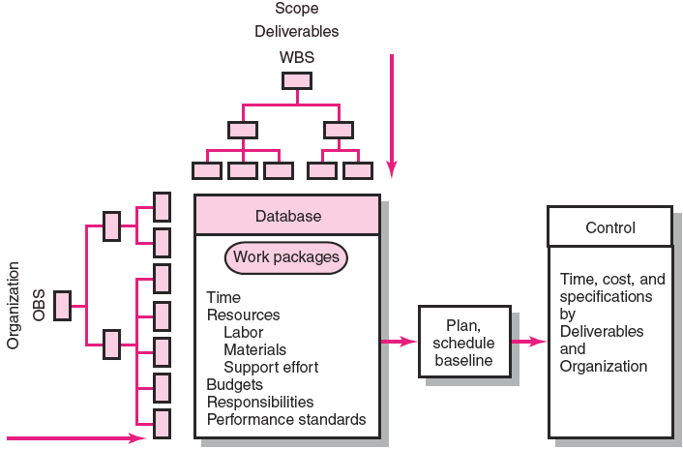
Project Management System Overview

Slide 17
Development of Project Baselines
Purposes of a Baseline (PV)
  An anchor point for measuring performance
    A planned cost and expected schedule against which actual cost and schedule are measured
    A basis for cash flows and awarding progress payments
    A summation of time-phased budgets (cost accounts as summed work packages) along a project timeline
What Costs Are Included in Baselines?
  Labor
  Equipment
  Materials
  Project direct overhead costs (DOC)

Slide 18
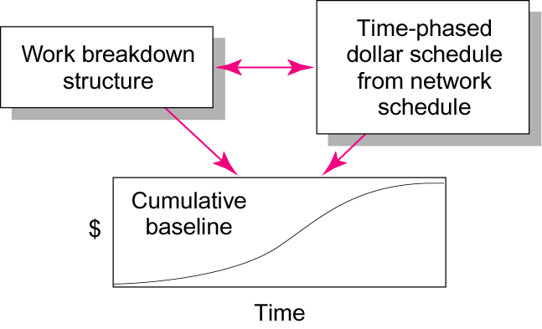
Baseline Data Relationships

Slide 19

Development of Project Baselines (cont’d)
Rules for Placing Costs in Baselines
  Costs are placed exactly as they are expected to be “earned” in order to track them to their point of origin.
  Percent Complete Rule
    Costs are periodically
    assigned to a baseline
    as units of work are
    completed over the
    duration of a
    work package.

Slide 20
Methods of Variance Analysis
Comparing Earned Value
  With the expected schedule value
  With the actual costs
Assessing Status of a Project
  Required data elements
    Data Budgeted cost of the work scheduled (PV)
    Budgeted cost of the work completed (EV)
    Actual cost of the work completed (AC)
  Calculate schedule and cost variances
    A positive variance indicates a desirable condition, while a negative variance suggests problems or changes that have taken place.

Slide 21
Methods of Variance Analysis
Cost Variance (CV)
  Indicates if the work accomplished using labor and materials costs more or less than was planned at any point in the project
Schedule Variance (SV)
  Presents an overall assessment in dollar terms of the progress of all work packages in the project scheduled to date

Slide 22
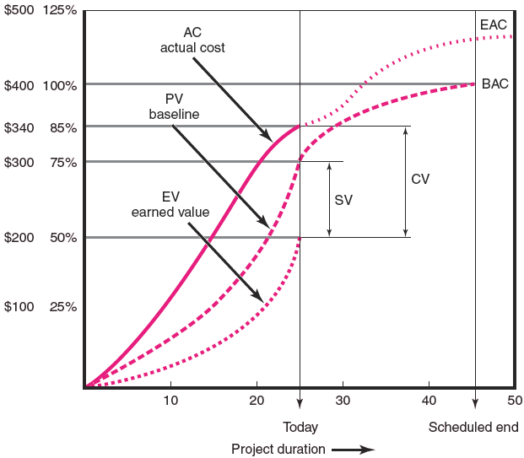
Cost/Schedule Graph

Slide 23
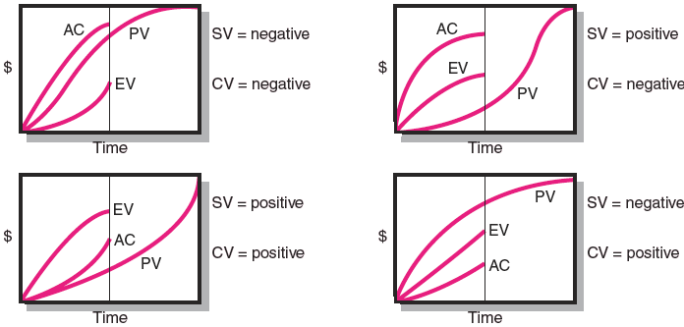
Earned Value Review Exercise

Slide 24
Developing A Status Report:
A Hypothetical Example
Assumptions
  Each cost account has only one work package, and each cost account will be represented as an activity on the network.
  The project network early start times will serve as the basis for assigning the baseline values.
  Baseline value will be assigned linearly, unless stated differently.
  From the moment work on an activity begins, some actual costs will be incurred each period until the activity is completed.

Slide 25
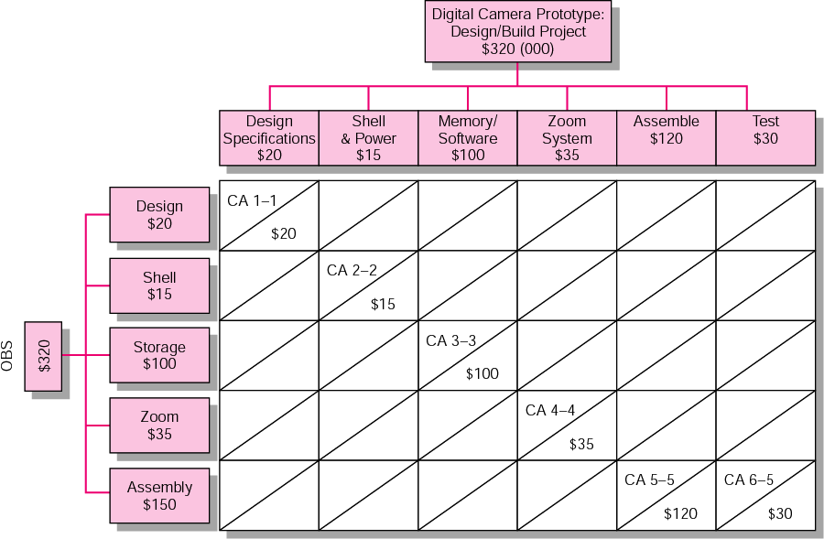
Work Breakdown Structure and Cost Accounts

Slide 26
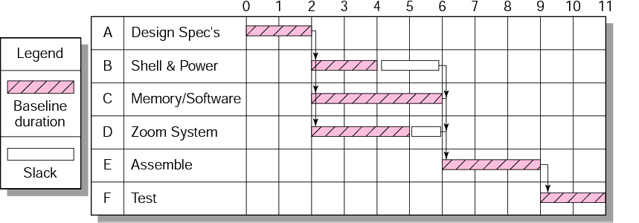
Digital Camera Prototype Project Baseline Gantt Chart

Slide 27
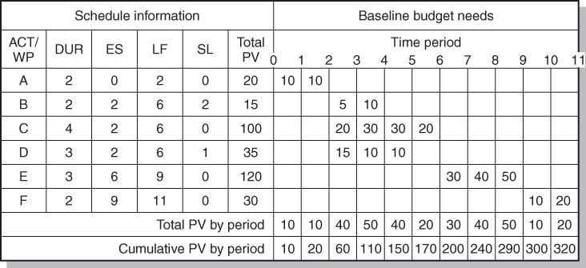
Digital Camera Prototype Project Baseline

Slide 28
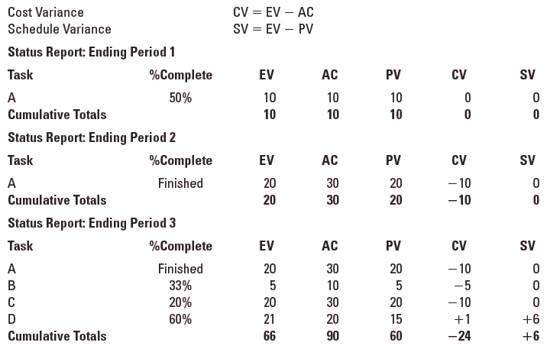
Digital Camera Prototype Status Reports: Periods 1–3

Slide 29
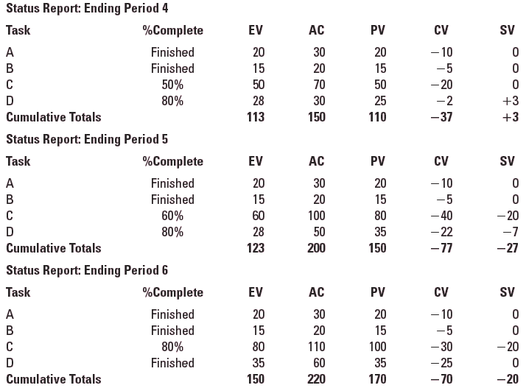
Digital Camera Prototype Status Reports: Periods 4–6

Slide 30
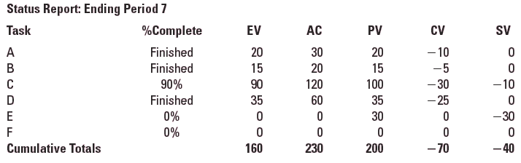
Digital Camera Prototype Status Reports: Period 7

Slide 31
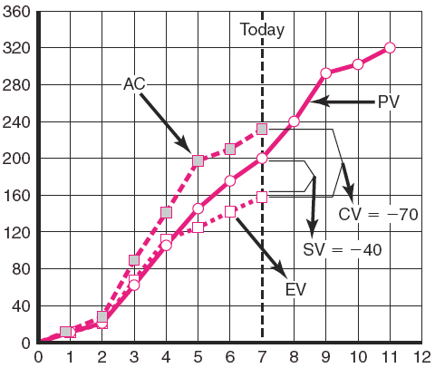
Digital Camera Prototype Summary Graph (000)

Slide 32
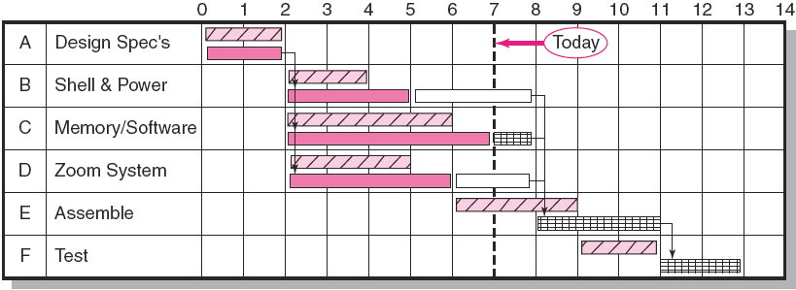
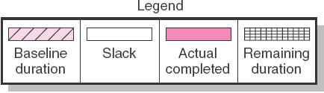
Digital Camera Project Tracking Gantt Chart
Showing Status—Through Period 7

Slide 33
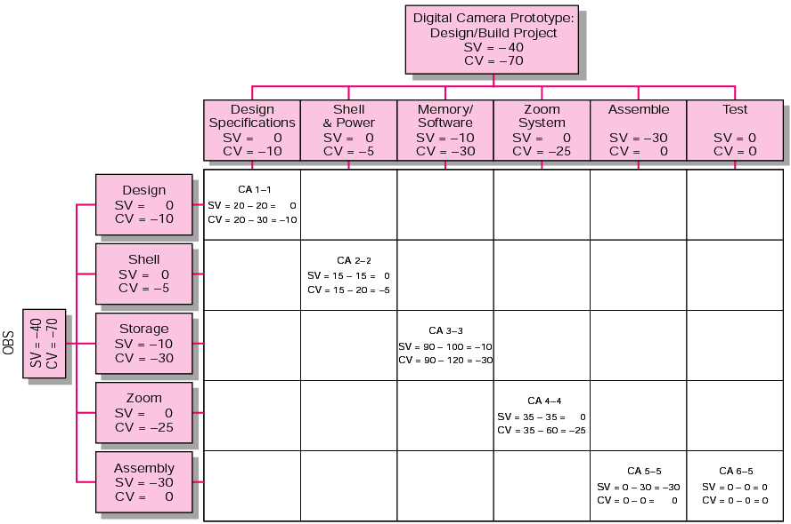
Digital Camera Project Rollup at End Period 7 (000)

Slide 34
Indexes to Monitor Progress
Performance Indexes
  Cost Performance Index (CPI)
    Measures the cost efficiency of work accomplished to date
    CPI = EV/AC
  Scheduling Performance Index (SPI)
    Measures scheduling efficiency
    SPI = EV/PV
  Percent Complete Indexes
    Indicates how much of the work accomplished represents of the total budgeted (BAC) and actual (AC) dollars to date
    PCIB = EV/BAC
    PCIC = AC/EAC

Slide 35
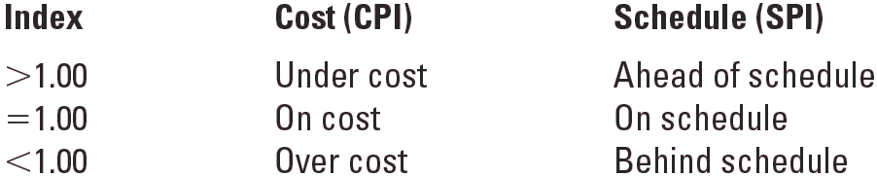
Interpretation of Indexes
TABLE 13.3

Slide 36
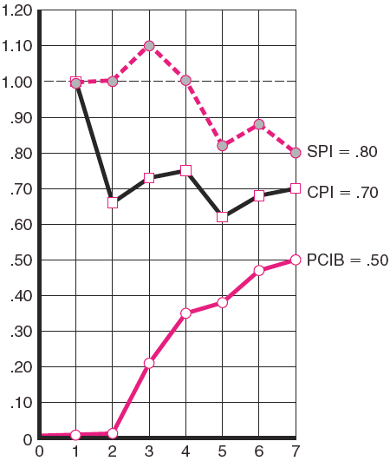
Indexes
Periods 1–7
FIGURE 13.13

Slide 37
Project Cost/Schedule Systems Software
Typical Computer-Generated Status Report
  Schedule variance (EV-PV) by cost account and WBS and OBS
  Cost variance (EV-AC) by cost account and WBS and OBS
  Indexes—cost, schedule, total percent complete, and the to complete performance index
  Cumulative actual total to date (AC)
  Expected costs at completion
  Paid and unpaid commitments

Slide 38
Additional Earned Value Rules
Rules Applied to Short-Duration Activities and/or Small-Cost Activities
  0/100 percent rule
    Assumes 100 % of budget credit is earned at once and only when the work is completed
  50/50 rule
    Allows for 50% of the value of the work package budget to be earned when it is started and 50% to be earned when the package is completed

Slide 39
Forecasting Final Project Cost
Methods Used to Revise Estimates of Future Project Costs:
  EAC_{re}
    Allows experts in the field to change original baseline durations and costs because new information tells them the original estimates are not accurate
  EAC_{f}
    Uses actual costs-to-date plus an efficiency index to project final costs in large projects where the original budget is unreliable

Slide 40

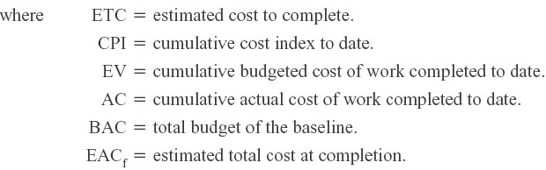
Forecasting Model: EAC_{f}
The equation for this forecasting model:

Slide 41
To Complete Performance Index (TCPI)
BAC - EV
TCPI= BAC – AC
TCPI = the amount of value each remaining dollar in the budget must earn to stay within budget

Slide 42
Other Control Issues
Issues In Maintaining Control Of Projects
Baseline Changes
Contingency Reserve
Costs and Problems of Data Acquisition
Scope Creep
Managing the Portfolio of Projects

Slide 43
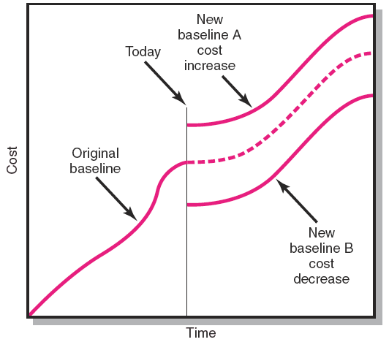
Scope Changes to a Baseline
FIGURE 13.14

Slide 44
Key Terms
Base line budget Schedule performance
Control Chart index (SPI)
Cost performance Schedule variance (SV)
index (CPI) Scope creep
Cost variance (CV) To complete performance
Earned Value (EV) index (TCPI)
Estimated cost at Tracking Gantt chart
completion (EAC_{re}) Variance at completion (VAC)
Percent complete index

